Slide 1
An Overview of the Aloha protocols

Slide 2
History
One of the early computer networking designs
Developed at the U of Hawaii in 1970 under the leadership of N Abramson.
Wanted to create a wireless network that would allow remote UH campuses to access centrally-located computing resources

Slide 3
Basic design
Original version used hub/star topology
Hub computer broadcasted packets to everyone on an outbound channel
Client machines sent data to the hub on a shared inbound channel

Slide 4
Handling contention
Client machines transmit without knowing whether another clients transmit at the same
No reservations
No time-domain multiplexing
Cannot either detect collisions
Their own signal always overpowers signals from other clients

Slide 5
The solution
Hub site immediately retransmits the packets it has received on its broadcast channel
Any client noticing one of its packets was not acknowledged
Waits a short time
Retransmits the packet

Slide 6
Aloha and Ethernet (I)
Aloha predates Ethernet by several years
Like Aloha
Ethernet clients share a single contention channel
Retransmits packets that were damaged due to a collision

Slide 7
Aloha and Ethernet (II)
Unlike Aloha
Ethernet clients sense the network before transmitting a packet
Abort packet transmission as soon as they detect a collision
Both options are not possible on a packet radio network

Slide 8
A concise view of the protocol
If you have data to send, send the data
If the message collides with another transmission, try resending "later"
http://en.wikipedia.org/wiki/ALOHAnet

Slide 9
Analysis (I)
Let d be the duration of a packet transmission interval
Let G the average number of packets transmitted per transmission interval
Including retransmissions
A packet will collide with any packet sent
Less than d time units before it was transmitted
While it was transmitted

Slide 10
The “danger zone”
Colliding packet
Packet being sent
Colliding packet
2d

Slide 11
The results
Throughput S
= G Prob[successful transmission]
= G Prob[no collision]
= G Prob[no other transmission within 2d]
= G exp(-2G)
Reaches maximum for G = 0.5
Maximum throughput is 18.4% of bandwidth

Slide 12
Slotted Aloha
(Roberts 1972)
Divides time into fixed-size slots
Slot sizes is equals to packet transmission time
Clients must wait until start of next slot before sending a packet
Packets either overlap completely or not at all
Danger zone is duration of a slot

Slide 13
The “danger zone” for slotted Aloha
Slot
Slot
Slot
Colliding packet
Packet being sent
Packet being sent
Packet being sent
d

Slide 14
Analysis
Throughput S
= G Prob[successful transmission]
= G Prob[no collision]
= G Prob[no other transmission within slot]
= G exp(-G)
Reaches maximum for G = 1
Maximum throughput is 36.8% of bandwidth

Slide 15
Finite-population slotted Aloha
Let G_{i} be the total transmission rate of user i for i = 1, 2, …, N in number of packets per slot
Let S_{i} be the number of new packets generated by user i during a given slot.
G_{i} is also the probability that user i transmits a packet during a slot.

Slide 16
Finite-population slotted Aloha
We have
S_{i} = G_{i} Π_{i ≠ j} (1 – G_{j})
If S_{i} = S/N and G_{i} = G/N
S = G [1 – G/N ]^{N-1}
and
lim_{N->∞} S = G [1 – G/N ]^{N-1} = exp(-G)

Slide 17
Implementation details
Clients never schedule the transmission of a new packet before the previous packet has been correctly received by the hub site
Each client maintains a queue of packets ready for transmission and transmits them one by one

Slide 18
Frame Slotted ALOHA
The ALOHA algorithm is a collision resolution algorithm based on Time Division Multiple Access (TDMA).
There are three flavors of the original ALOHA algorithm:
(Pure) ALOHA,
SlottedALOHA and
FrameSlotted ALOHA

Slide 19
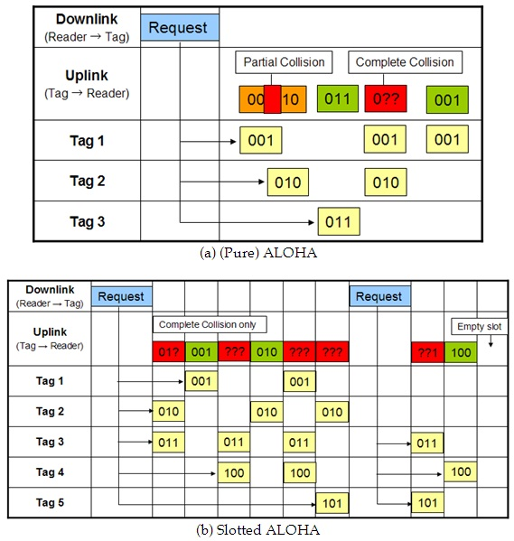

Slide 20
The read cycle is divided into discrete time intervals called slotand which is synchronized with the entire tags by the reader. Thus, tags must choose one of the slots randomly and transmit data within a single slot. Transmission begins right after a slot delimiter. This causes that packets either collide completely or don’t collide at all i.e. there is no partial collision in the Slotted ALOHA algorithm.

Slide 21
This reduces wasting the read cycle relatively as compared with the (Pure) ALOHA algorithm.
However, the empty slot can be occurred in the read cycle and the disadvantage is that it requires a synchronization mechanism in order for the slot-begin to occur simultaneously at all tags.

Slide 22
Framed slotted ALOHA
Framed SlottedALOHA algorithm uses the frame which is the discrete time interval of the read cycle and each frame is divided into the same number of slots.
There are multiple frames in a single read cycle and the frame size is decided by the reader (Figure 3)
There is a constraint that the tags can transmit data only once in each frame. It may reduce the number of collided slots and it shows the best performance among them.

Slide 23
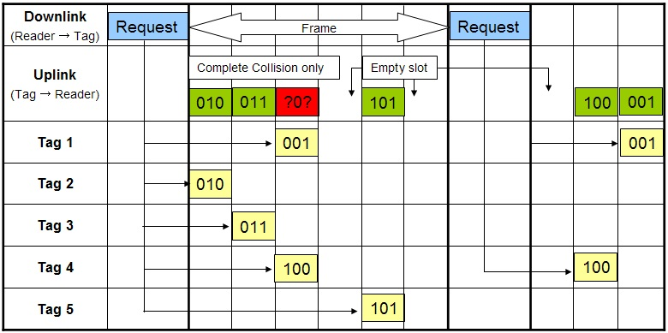
Framed Slotted ALOHA Algorithms

Slide 24
